Slide 1
How is COVID-19 influencing intent to visit cultural entities?
Chief Market Engagement Officer, IMPACTS Reasearch and Development
colleendilen.com

Slide 2
The US public anticipates soon resuming their more “normal” behaviors attending visitor-serving cultural enterprises.* *provided that we make them aware of additional measures to keep them safe.
Source: Colleen Dilenschneider, “DATA UPDATE: How COVID-19 is Impacting Intentions to Visit Cultural Entities,” Know Your Own Bone (blog), April 27, 2020, www.colleendilen.com

Slide 3
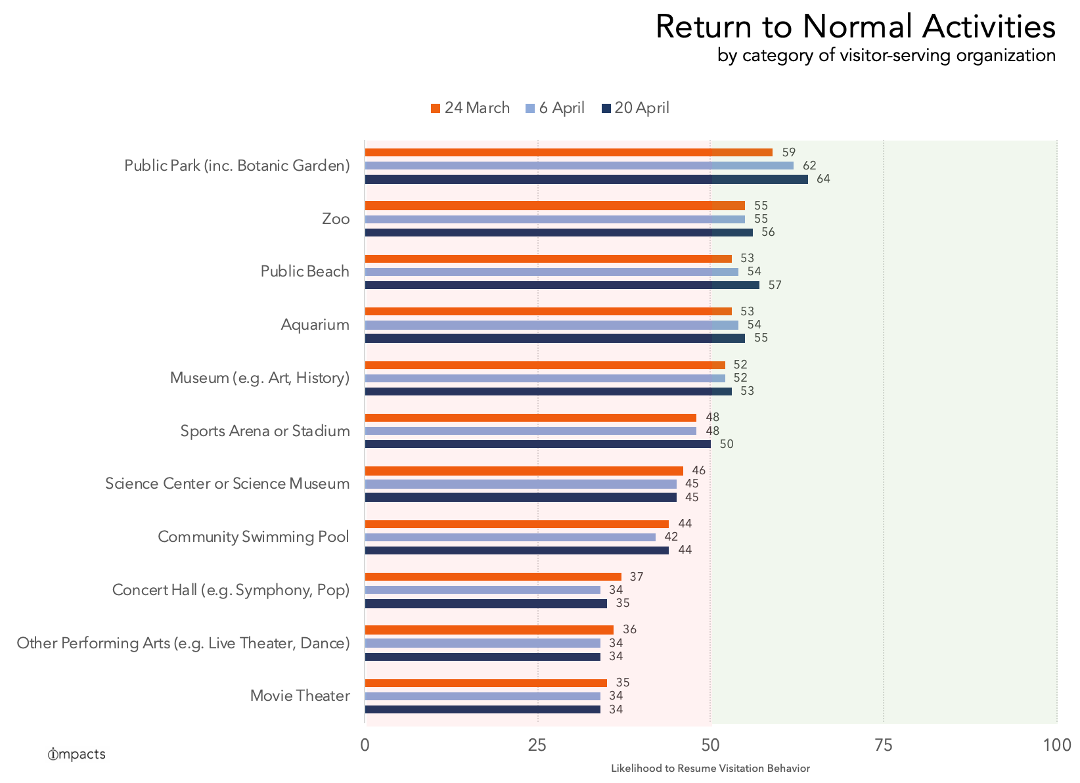

Slide 4
Without operational and strategic changes to prioritize safety….
1 in 4 people feel comfortable attending exhibit-based institutions (museums, historic sites).
1 in 7 feel comfortable attending performance-based institutions.
Source: Colleen Dilenschneider, “Performance Vs. Exhibit-Based Experiences: What Will Make People Feel Safe Visiting Again?,” Know Your Own Bone (blog), April 15, 2020, www.colleendilen.com

Slide 5
What will make people feel safe attending performances again?

Slide 6
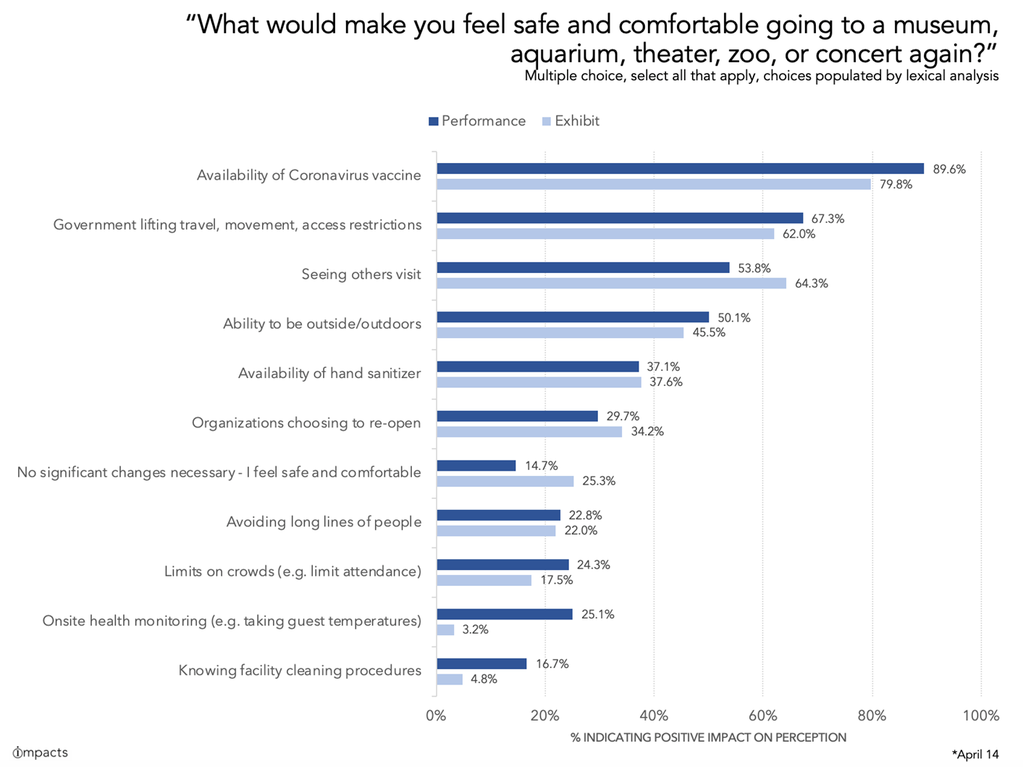

Slide 7
Factors that we can control:
Ability to be outside/outdoors
Availability of hand sanitizer
Avoiding long lines of people
Limits on crowds (e.g. limit attendance)
Onsite health monitoring (e.g. taking temperatures)
Knowing facility cleaning procedures
Source: Colleen Dilenschneider, “Performance Vs. Exhibit-Based Experiences: What Will Make People Feel Safe Visiting Again?,” Know Your Own Bone (blog), April 15, 2020, www.colleendilen.com

Slide 8
Tom Clareson
Project Director
Mollie Quinlan-Hayes
ArtsReady Director, South Arts

